Slide 1
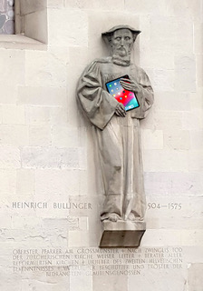
LLMs for Bullinger Digital www.bullinger-digital.ch
Dominic Fischer, Martin Volk
Patricia Scheurer, Phillip Ströbel

Slide 2
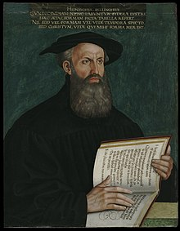
Reformers (and their letter correspondences)
Martin Luther (1483-1546): 63 years - 4300 letters
Huldrych Zwingli (1484-1531): 47 years - 1300 letters
Heinrich Bullinger (1504-1575): 71 yrs - 12’000 letters
Johannes Calvin (1509-1564): 55 yrs - 4200 letters
Notes:
Quelle: T. Schieß (1932): Der Briefwechsel Heinrich Bullingers
1369 von Calvin selbst
The letters are 75% in Latin and almost 24% in Early New High German, many
with a mixture of both. 3100 letters have been professionally edited and published, another
5400 letters had been manually transcribed.

Slide 3
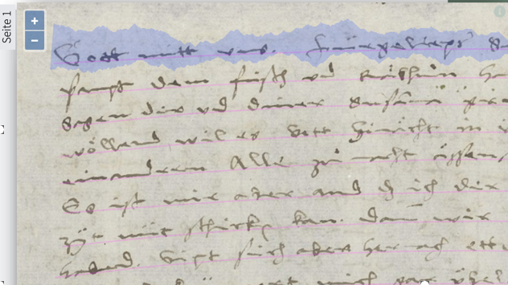
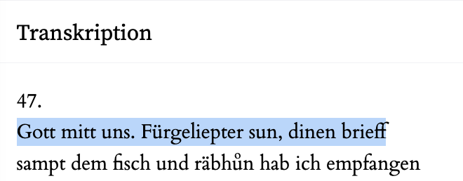
Automatic Handwriting Recognition
Heinrich Bullinger to his son Hans Rudolf Bullinger, 1. December 1565

Slide 4
Machine Translation

Slide 5
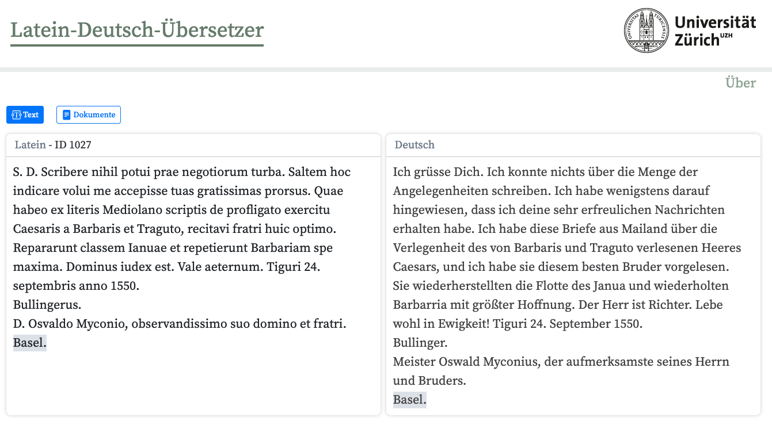
Heinrich Bullinger to Oswald Myconius, 24. September 1550

Slide 6
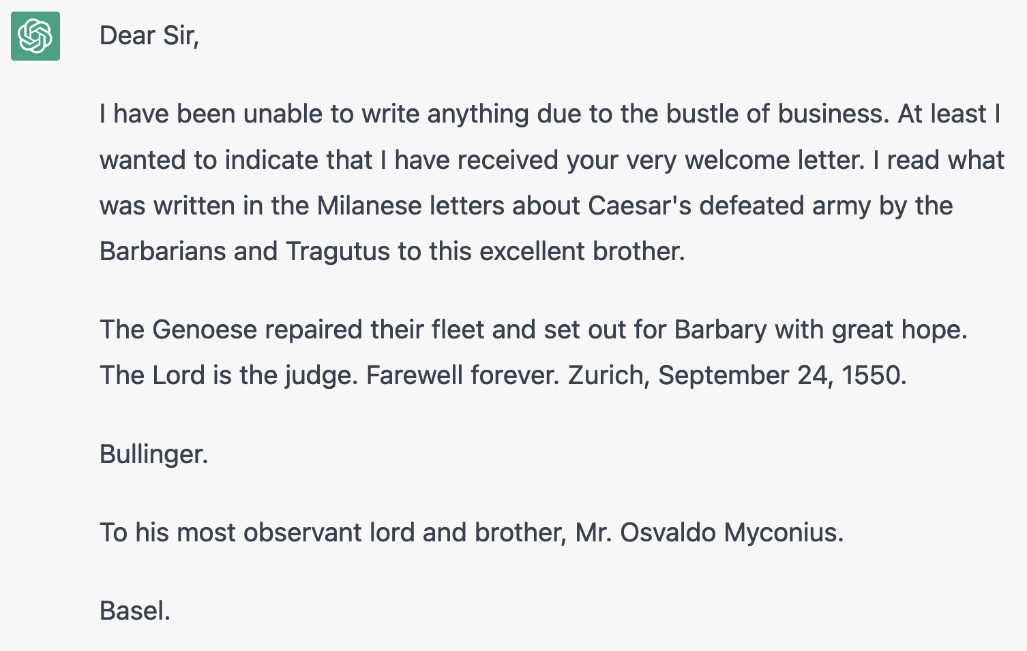
Translated from Latin to English by ChatGPT 3.5 on 9. March 2023

Slide 7
ChatGPT: Robustness against mixed texts
Quod res nostras attinet, pacatiora nunc sunt omnia per domini gratiam quam ante aliquot dies; es ließ sich ansehen, es müßt eins mals sin.
ChatGPT: As far as our affairs are concerned, everything is now more peaceful through the grace of the lord than it was a few days ago; it seemed apparent, it had to be that way at one point.
Johannes Haller d. J. an Heinrich Bullinger, 5. Juni 1560

Slide 8
Machine Translation Examples: LA to EN
MT Latin → English
Latin: Cęsaris astus mirari satis non valeo, magis autem nostrorum, non dico negligentiam, sed infelicitatem, qua non possunt in astutiis illum deprehendere
Google: I am not able enough to marvel at the cunning of Caesar, but rather of ours, I do not mean the negligence, but the unhappiness, by which they cannot detect him in his cunning.
GPT-4: I can't help but marvel at Caesar’s cunning, but even more so at our own, I don't say negligence, but misfortune, which can't catch him in his tricks.
GPT-4: I can't help but marvel at the emperor’s cunning, but even more so at our own, I don't say negligence, but misfortune, which can't catch him in his tricks.
Include in the prompt: Translate caesar as emperor…
Oswald Myconius to Heinrich Bullinger, 30. October 1546

Slide 9
Machine Translation Results: LA to DE/EN
Evaluation results – BLEU Scores
MT System | MT Latin into DE | MT Latin into EN
Google Translate | 17.53 | 25.22
GPT-4 | 27.07 | 34.50
BLEU Score:
Machine Translation Metric: Measures n-gram overlap
In this case: 1-grams to 4-grams.
Ranges from 0 (no overlap) to 100 (identical texts)

Slide 10
Machine Translation Examples: ENH-DE to EN
MT ENH-German → English
Original: Und diewyl sunst nut ist in üwerm schryben, daruff ich ze antworten bedarff, fuͤg ich üch ze wüssen, das min herren 30. septembris raͤdt und burger gehept.
GPT-4: And since there is nothing else in your letter that requires me to respond, I inform you that my lords held a council and citizens meeting on September 30.
Google: And the next day is in a lot of writing, to which I need an answer, because I even know that the gentlemen on September 30th cycled and had burgers.
Heinrich Bullinger to Ambrousius Blarer, 1. November 1546

Slide 11
Automatic Summarization

Slide 12
Automatic Summarization (GPT-4)
Summarization Latin → English
Latin: Preterea in vulgum eructavit fama Helvecios nostros simultatem inter sese nutrire, partium cęsaris seu Cattorum principis affectibus motos; quo dubitatur ex bellico successu Helveticam amiciciam dissecatum iri. Si quid huiusce rei futurum senseris, curiosum amici animum tuis scriptis solve.
Human: The Confederates are said to be divided because some support the Hessian Landgrave, while others side with the Emperor. This raises the question of whether the war will lead to the breakdown of the friendship among the Helvetians. What does Bullinger think about this?
GPT-4: Furthermore, there is a rumor circulating among the public that the Swiss are fostering internal strife, driven by the influences of the Caesar's party or the Prince of the Catholics. This has led to doubts about whether the success of the war will tear apart Swiss friendship. Travers asks Bullinger to clarify this matter in his writings if he has any insight into what might happen.
Evaluation: Names | Events & Times | Information Complete | Information Correct
Johannes Travers an Heinrich Bullinger, 22. Oktober 1546

Slide 13
Automatic Summarization – Evaluation Results
 | Names | Events/Time | Complete | Correct
Judge 1 | 44 | 56 | 49 | 43,5
Judge 2 | 45 | 52 | 46,5 | 36,5
Judge 3 | 52,5 | 55,5 | 49 | 50,5
Average | 47,2 | 54,5 | 48,2 | 43,5
Avg thereof | 48.3 / 58 = 0,83…
Total: 58 paragraphs from 10 letters
Judges saw only the human and the automatic summary.
Score: min. 0 – 0.5 – max. 1 point

Slide 14
Automatic Name Recognition

Slide 15
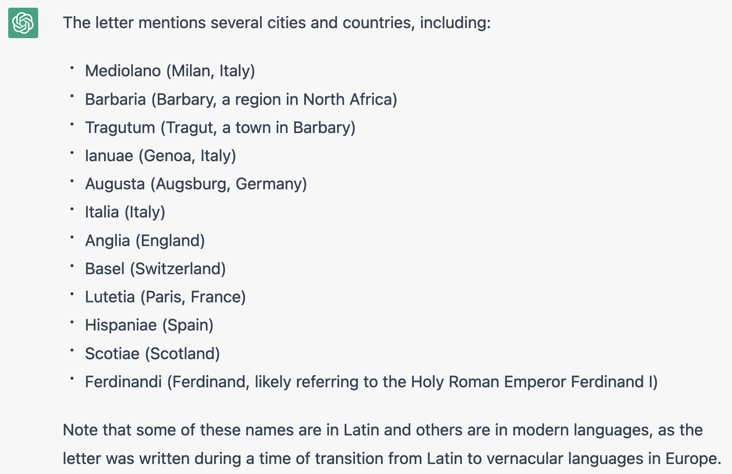
GPT for Name Recognition
prompt: Which city and country names are in this letter?

Slide 16
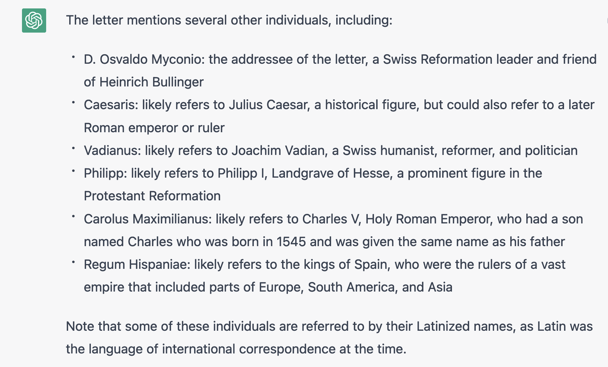
GPT for Name Recognition
prompt: Which persons appear in this letter?

Slide 17
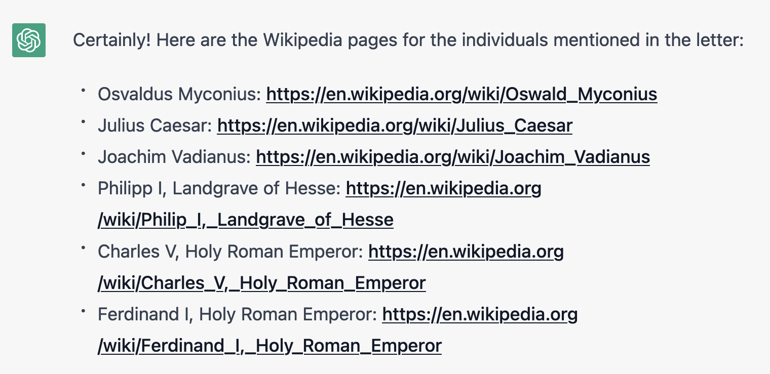
GPT for Name Recognition
prompt: Can you provide URLs to Wikipedia pages for these people?

Slide 18
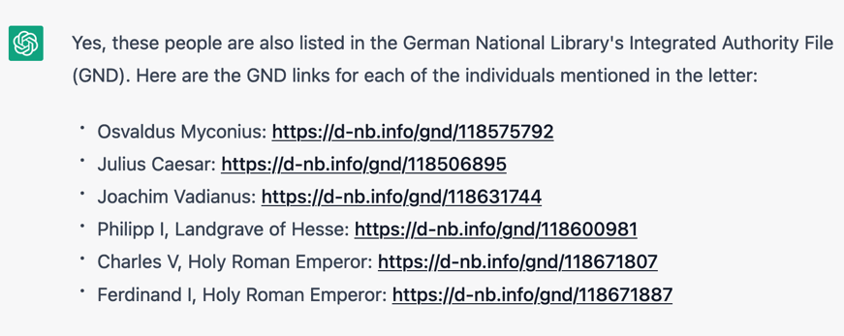
GPT for Name Recognition
prompt: Are these people also in the German database GND? Can you provide links for these people?

Slide 19
A brief Outlook…

Slide 20
Visualizing History (ChatGPT, Nov. 2023)
User: Generate an image of the Zurich reformer Heinrich Bullinger as he gives a letter to a messenger.
ChatGPT: Here is an image depicting Heinrich Bullinger,
a significant figure in the Zurich Reformation during the 16th century,
as he hands a letter to a messenger.
The setting reflects a historical European city environment from the 1500s,
with Bullinger in period-appropriate clerical attire and the messenger in simple clothing of the era.
The background captures the essence of the city's architecture at that time.
Notes:
Images generated with ChatGPT-4 on 15th November 2023

Slide 21
